Slide 1
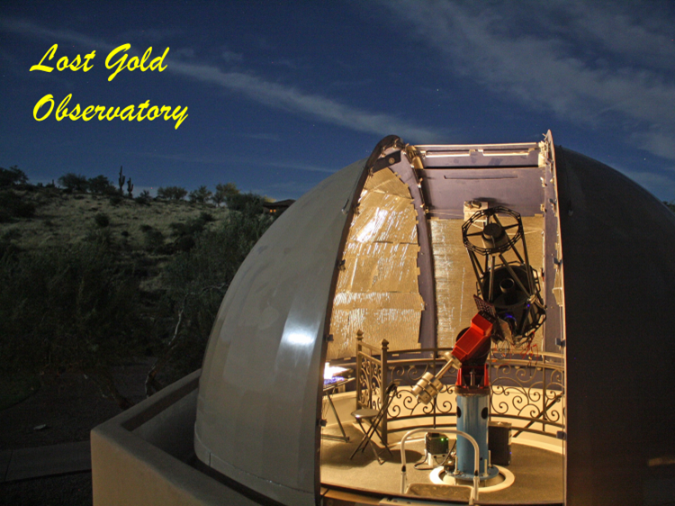
Small Telescopes in the New Era of Big Telescope Surveys Photometry, Spectroscopy & Backyard Astronomers
Robert K. Buchheim
Society for Astronomical Sciences
American Association of
of Variable Star Observers
Who we are
What we can do
Pro – Am Collaborations

Slide 2
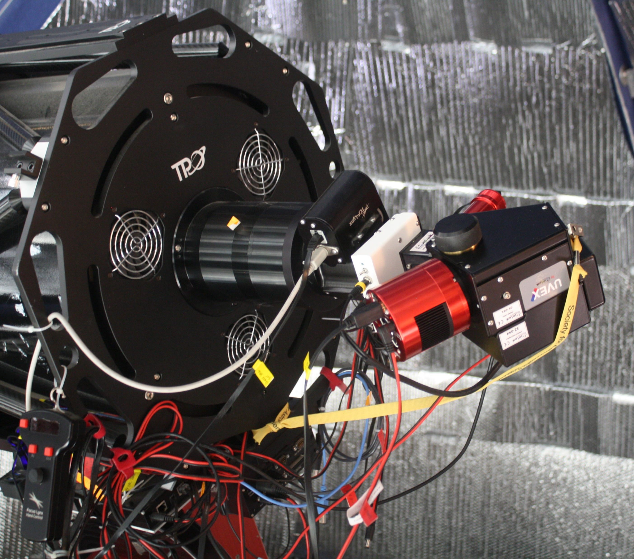
16-inch F/8 RC ‘scope
UVEX spectrograph
ST-8XE CCD photometry

Slide 3
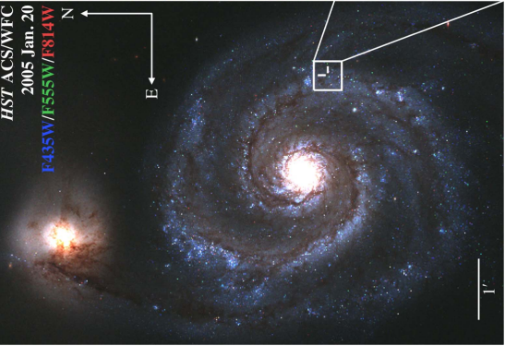
M51 image from HST ACS/WFC (2005 pre-event)
In 2019, something happened …

Slide 4
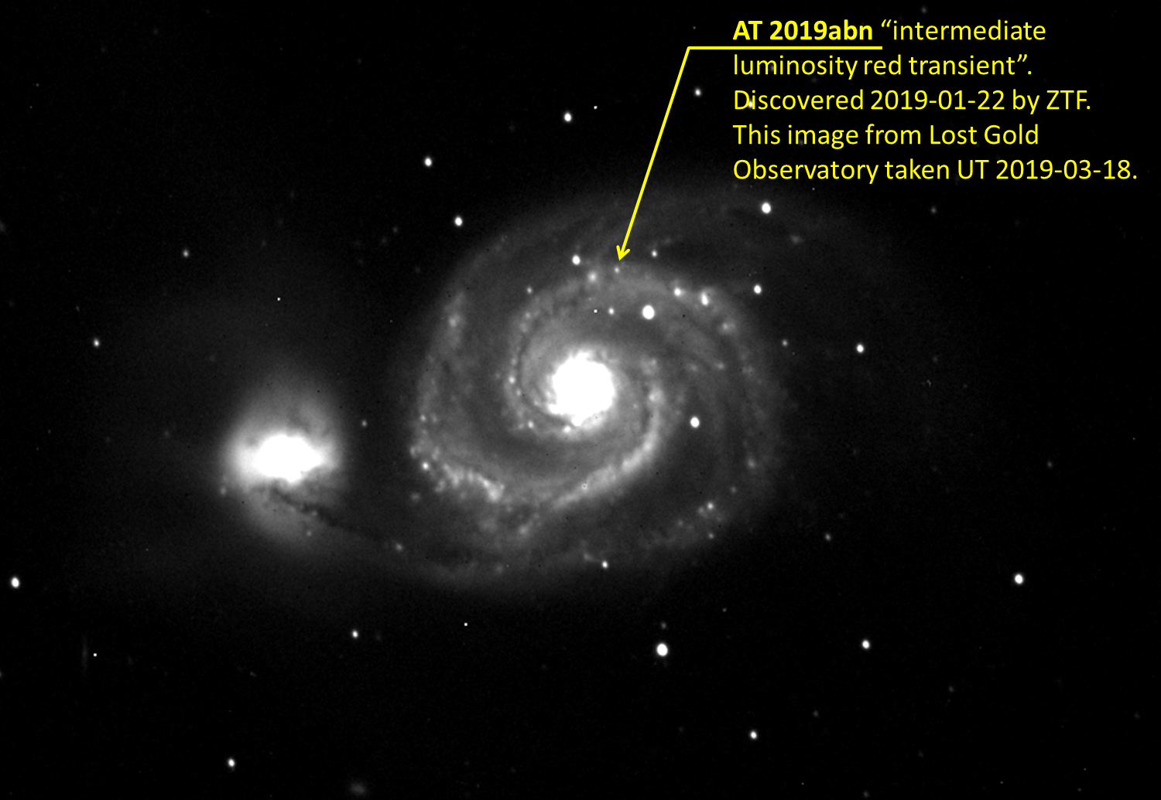

Slide 5
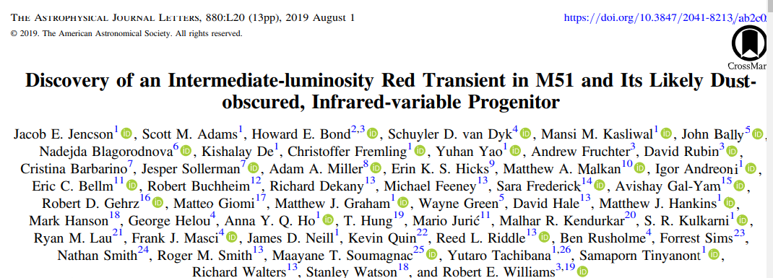

Slide 6
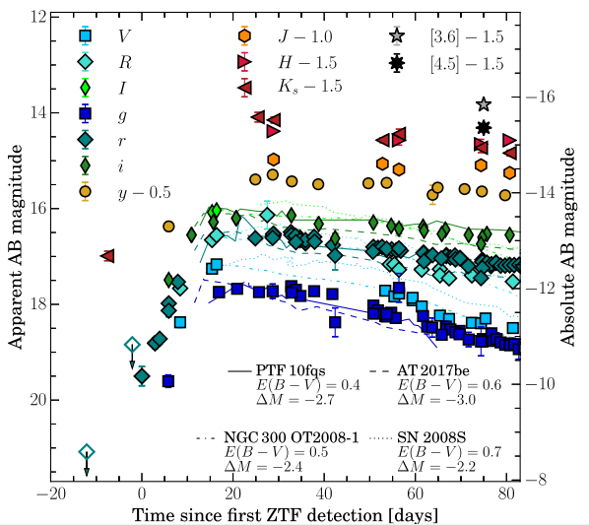
Almost all of the V- and R-band photometry, and some of the g-band, came from amateur astronomers
Quick Response, adaptable
Nightly cadence
Geographic diversity (weather)

Slide 7
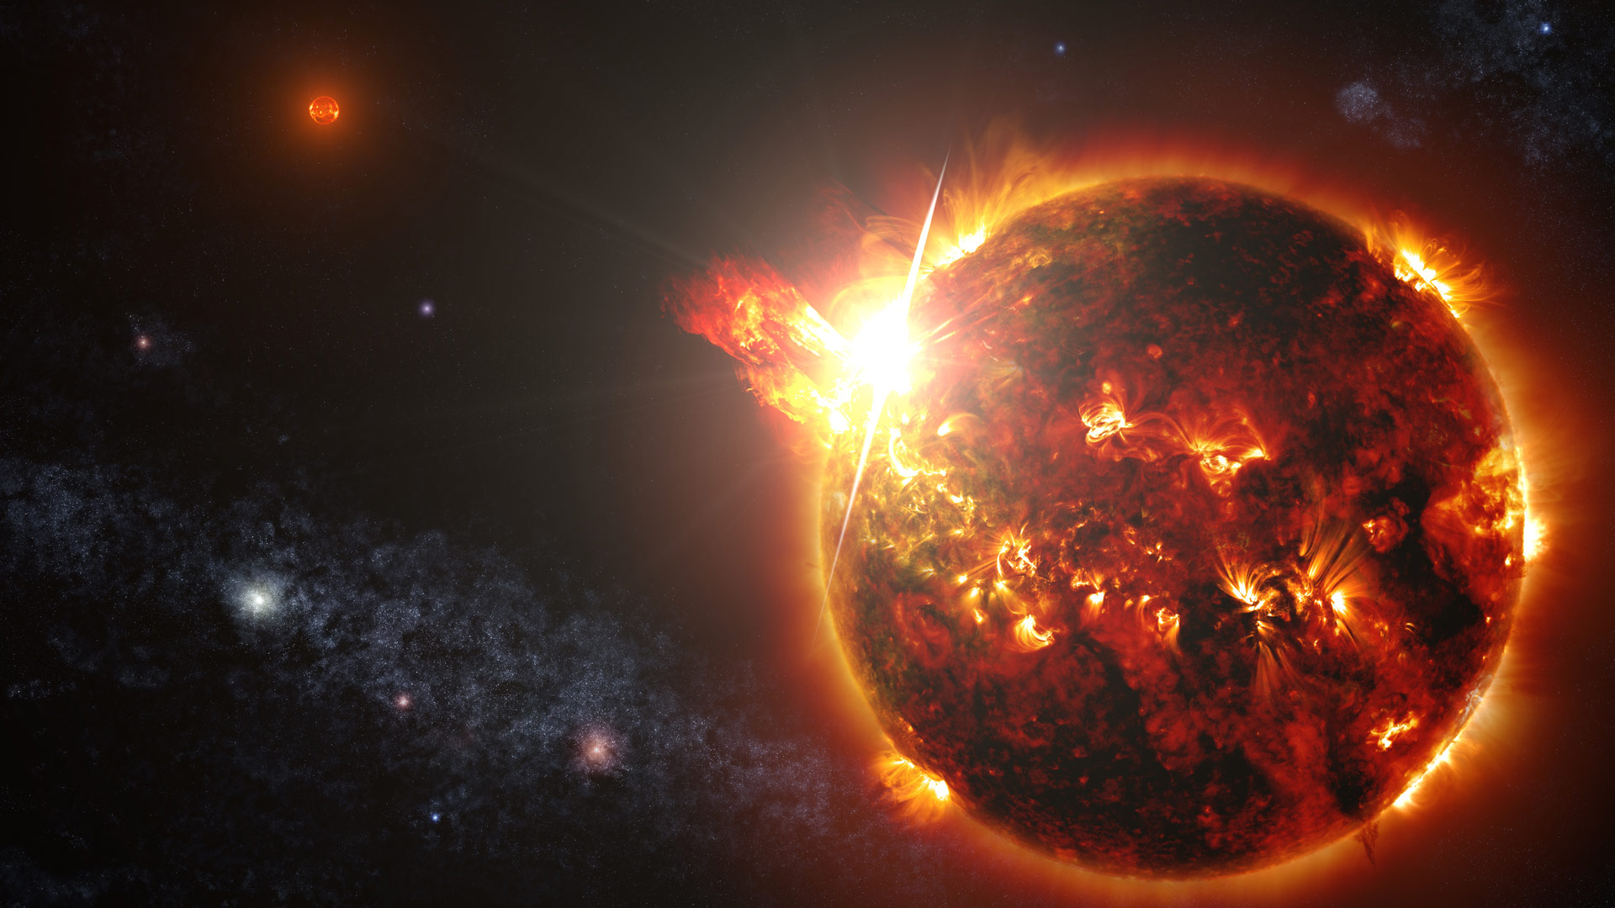
Stellar Flares: Spectro-Photometry
Random events = Lots of telescope time
Continuous time-series for 4-8 hours
Uncertain odds of success
(DG CVn) Image credit:
NASA Goddard Space Flight Center
S. Wiessinger

Slide 8
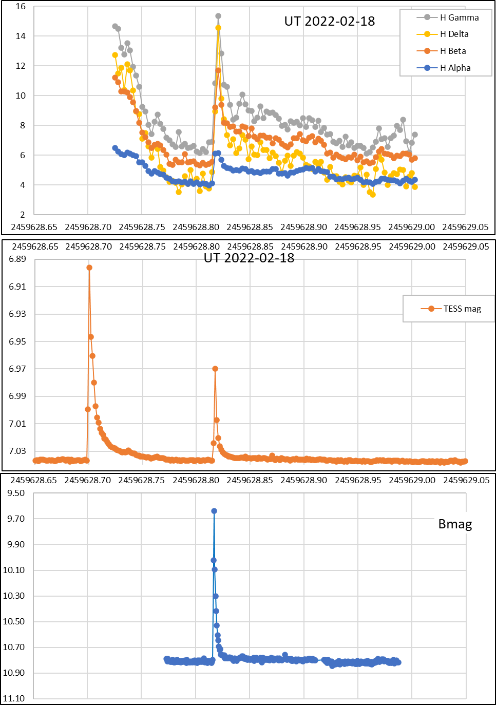
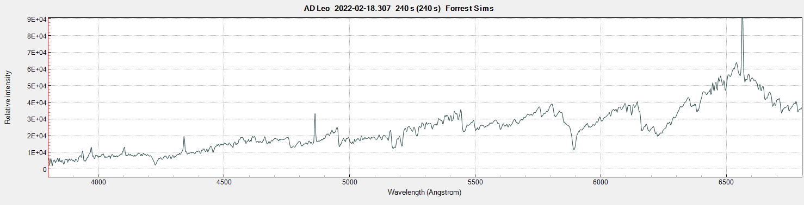
Stellar Flares: Spectro-Photometry

Slide 9
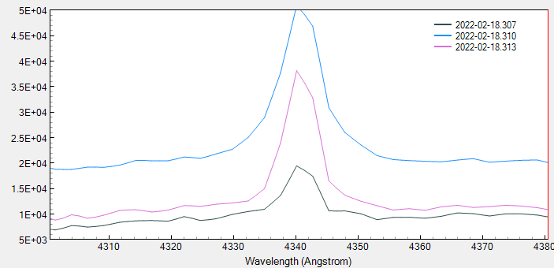
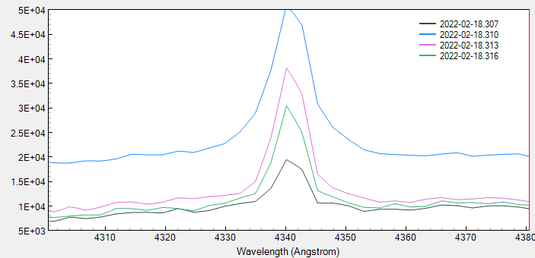
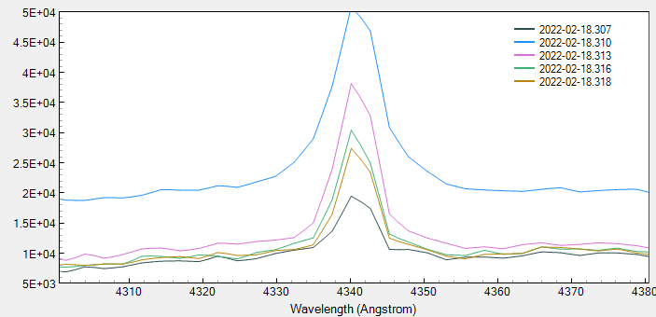

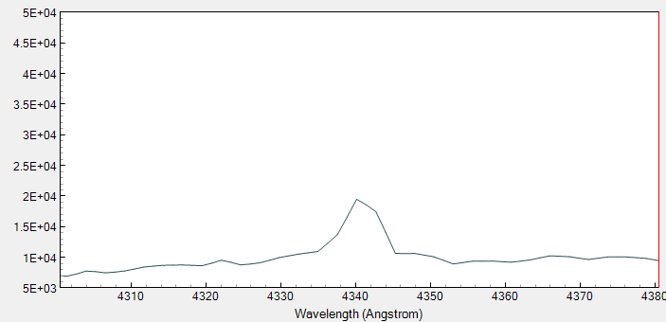
AD Leo H-gamma line during flare event 240s (4 min) exposures, ≈250s cadence

Slide 10
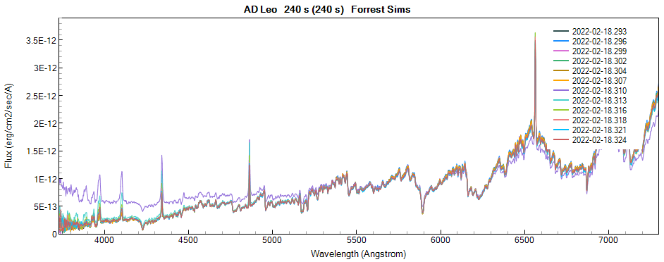
Spectro-Photometry of Stellar Flares
Rapid rise of continuum and line emission, followed by
rapid fall of continuum,
more gradual fading of line emission
Major investment of observing time
Rare & short-lived events:
Simultaneous time-series spectroscopy + photometry
Teamwork
Spectrum every 4.3 minutes
(R≈1000)
Flux calibrated to simultaneous photometry

Slide 11
Pro-Am Collaboration
Professional Astronomers know:
Useful / unresolved questions
Results that need replication
Observations that haven’t yet been done (limited telescope time)
We might be able to help:
Telescope time
Continuous Cadence … Long time spans
Uncertain probability of success

Slide 12

Partition the Cosmos along three axes …
dynamic
Bright
invariant
Faint
time scale of variability

Slide 13
Partition the Cosmos along three axes …
Big Professional observatories:
Faint objects
Over-subscribed
Amateurs:
Can do “all night, every night for a long time” if we want
Looking → Measuring
Can collaborate for 24-hour surveillance of target
More of us …
Recruited & organized: AAVSO
Asteroid lightcurves
dynamic
“Time series”
Transient
Events
Stellar variability
Double stars
Bright
Bright
Decades, years
Days, hours
invariant
Faint
Small # observations, repeated infrequently
time scale of variability

Slide 14
Backyard Astronomers Realm ………………………………………
Bright
Optical
10,000 Å
7000 Å
Photometry: Vmag≈ 0 – 17
Spectroscopy:
B- V- R-band
U- B- V- R- I- band
Wavelength (λ), Å
Spectroscopy
Low Res (R≈ 130-1500): Vmag≈ 0 – 16
Higher Res (R≈ 5000 – 20,000): Vmag≈ 0 – 10
V mag →
3500 Å
0 5 10 15 17

Slide 15
Discussion
The unresolved questions
The results that need replication
Observations that haven’t yet been done (limited telescope time)

