Slide 1
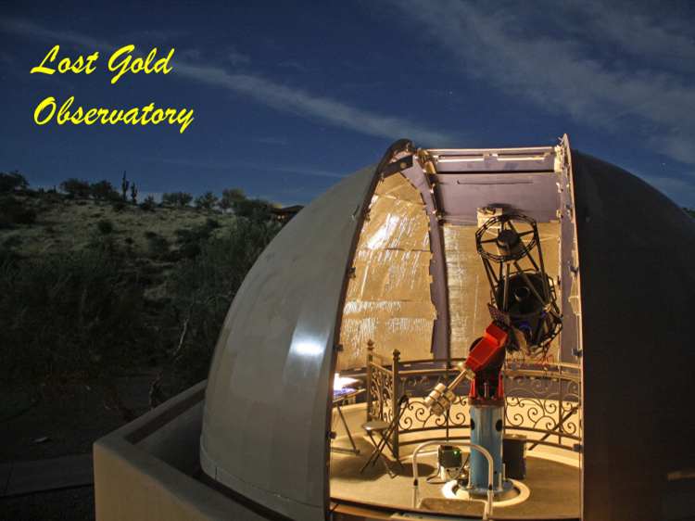
Flux-Calibrating Your Spectra
Concept, Practice, and Discussion
for AAVSO Spectroscopy On-Line Meeting
Bob Buchheim
Lost Gold Observatory, AAVSO, SAS
Reference: David Boyd (2020):
A method of calibrating spectra in absolute flux using V magnitudes
https://britastro.org/wp-content/uploads/2021/05/absfluxcalibration.pdf

Slide 2
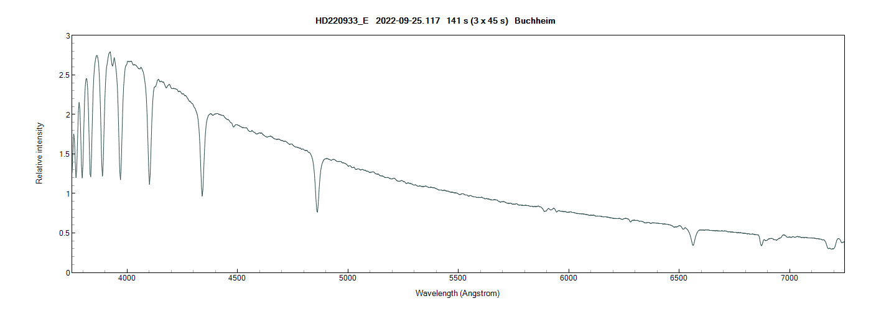
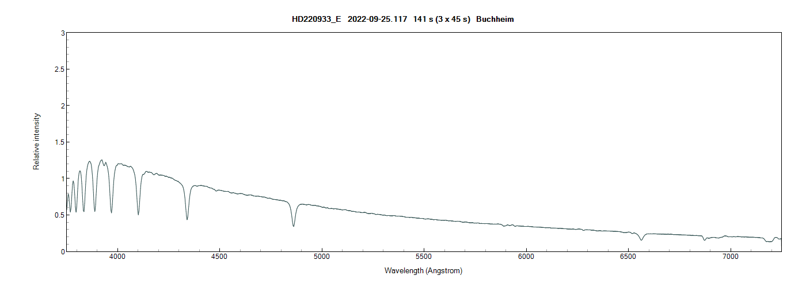
One way of looking at the relationship between spectrum and photometry
Brighter
Fainter
Identical spectral profiles
I_{F}/I_{B} = 0.45
Δmag = 0.87

Slide 3
Why flux-calibrate?
Different view of changes
Combine Spectra + Photometry
Spectral profile:
Rel Intensity vs λ
Flux-Calibrated Spectra
erg/s/cm²/Å vs λ

Slide 4
“Flux”: What do the units mean?
Apparent magnitude in filter / band
Flux density power/area
erg/sec/cm²
Spectral filter Δλ = 1 Å
erg/sec/cm²/Å
Power output
(luminosity)
erg/sec
There is a relationship between brightness (photometry) and spectral flux density (Y-axis of spectrum profile).
Our goal is to find it, and apply it to your “relative Intensity” spectra profiles.
distance
cm
?
?
Atmosphere Τ(λ, α)
(exo-atmospheric)
Observer
Spectral flux density:
erg/sec/cm²/Å
λ, Å

Slide 5
Simple: ISIS Command
Process spectrum as usual, FITS profile of Rel Int vs λ
Saved into “working directory”
Then:
ISIS > Tools
> Spectra3 menu
Enter:
Rel Int profile file name
File name for flux-cal’d file
V-mag
Select “Bessel V” and “GO”
Writes flux-calibrated FITS profile to Working Directory

Slide 6
Assumptions hidden within ISIS tool
Low- or medium-resolution spectrograph (e.g. ALPY, LISA)
R≈ 500 – 2000
Spectral range spans ≈ 4700 - 6700Å
“Simultaneous” V-mag of target
Your spectrum profile has been corrected for:
Instrumental + atmospheric response
Rel Int (exo-atmospheric) vs wavelength
Normalized (I_{REL} = 1) at some wavelength range
Star spectrum profile
Relative Intensity
V-band response profile
Wavelength (Angstroms)

Slide 7
V-band flux from target:
Target spectrum (erg/s/cm2/Å)
V-response
(normalized)
Multiply: received flux F(λ) times V-band Response function
Integrate over all λ
= F_{V}, in erg/s/cm²
F_{V}= area under curve
Assume:
Tgt_{Flux}(λ) = K* Tgt_{RelInt}(λ)
$$I_{Tgt}= \int{Tgt\left(λ\right)∗{Resp}_{V}\left(λ\right)dλ}$$

Slide 8
The Math …
$$I_{Tgt}=K\int{{Tgt}_{RelInt}\left(λ\right)∗{Resp}_{V}\left(λ\right)dλ}$$
Relative Intensity Tgt Spectrum
$$I_{Comp}=\int{{Comp}_{FluxCal}\left(λ\right)∗{Resp}_{V}\left(λ\right)dλ}$$
Flux-Calibrated Comp Star Spectrum
(e.g. CALSPEC Vega, Vmag= 0.03)
$$ΔVmag=V_{Tgt}−V_{Comp}=−2.5log\left[\frac{I_{Tgt}}{I_{Comp}}\right]$$
$${10}^{\frac{V_{Tgt}−V_{Comp}}{−2.5}}∗\frac{\int{{Comp}_{FluxCal}\left(λ\right)∗{Resp}_{V}\left(λ\right)dλ}}{\int{{Tgt}_{RelInt}\left(λ\right)∗{Resp}_{V}\left(λ\right)dλ}}=K$$
Use ISIS “Arithmetic” and “FWHM” tools to solve for value of K

Slide 9
Flux-calibrated “Comp star” spectra: CalSpec
“Intensity” is in erg/s/cm2/Å

Slide 10
Assumptions hidden within ISIS tool
Low- or medium-resolution spectrograph (e.g. ALPY, LISA)
R≈ 500 – 2000
Spectral range spans ≈ 4700 - 6700Å
“Simultaneous” V-mag of target
Your spectrum profile has been corrected for:
Instrumental + atmospheric response
Rel Int (exo-atmospheric) vs wavelength
Normalized (I_{REL} = 1) at some wavelength range
What if the Assumptions aren’t valid for your observations?
Star spectrum profile
Relative Intensity
V-band response profile
Wavelength (Angstroms)

Slide 11
UVEX spectrum range (grating angle = 4600Å)
HD038545
V-band Response
B-band Response
The concept & equations are valid even if:
Your spectra doesn’t span full wavelength range of V-band (e.g. my UVEX), or
You do photometry in tri-color R-G-B, or …?
The equation for K still works (using “your” filter/band and magnitude)!

Slide 12
Summary
Why flux-calibrated spectra?
Relationship between Magnitude, Flux, and Spectrum Profile
ISIS built-in Calculator
Some Equations …
Why V-magnitudes?
Purely matter of convenience, and generally good match to Shelyak spectrographs (ALPY, LISA)
Same concept/math works with B-band (e.g. my UVEX), or R-G-B tri-color
Questions? Discussion?

Slide 13
Addendum: David Boyd’s equation and mine are actually identical … he uses the “Zero Point” concept (more astronomical than my equation).
David defines:
So that
My equation is:
where
Exercise for the student: show that
See next slide …
$$F=\int{{Comp}_{FluxCal}\left(λ\right)∗{Resp}_{V}\left(λ\right)dλ}$$
$${Tgt}_{flux}\left(λ\right)=K∗{Tgt}_{RelInt}\left(λ\right)$$
$$ZP=−V_{Comp} −2.5∗log⁡(F)$$
$${K=10}^{\frac{V_{Tgt}−V_{Comp}}{−2.5}}∗\frac{\int{{Comp}_{FluxCal}\left(λ\right)∗{Resp}_{V}\left(λ\right)dλ}}{\int{{Tgt}_{RelInt}\left(λ\right)∗{Resp}_{V}\left(λ\right)dλ}}$$
$$A={10}^{\left[−0.4∗\left(V_{Tgt}+ZP\right)\right]}$$
$$R=\int{{Tgt}_{RelInt}\left(λ\right)∗{Resp}_{V}\left(λ\right)dλ}$$
$$\left(\frac{A}{R}\right)=K$$
$${Tgt}_{flux}\left(λ\right)= \left(\frac{A}{R}\right){Tgt}_{RelInt}\left(λ\right)$$

Slide 14
Hints:
$$A={10}^{\left[−0.4∗\left(V_{Tgt}+ZP\right)\right]}$$
Put in the definition of ZP:
$$A={10}^{\left[−0.4∗\left(V_{Tgt}−V_{Comp} −2.5∗\log\left(F\right)\right)\right]}$$
Use 10^{[a+b]} = 10ª * 10^{b}
$$A={10}^{\left[−0.4∗\left(V_{Tgt}−V_{Comp} \right)\right]}∗{10}^{\log\left(F\right)}$$
Use 10^{[logF]} = F
$={10}^{\left[\frac{\left(V_{Tgt}−V_{Comp} \right)}{−2.5}\right]}∗F$
Put in the definition of F
$={10}^{\left[\frac{\left(V_{Tgt}−V_{Comp} \right)}{−2.5}\right]}∗\int{{Comp}_{FluxCal}\left(λ\right)∗{Resp}_{V}\left(λ\right)dλ}$
Then use the definition of R to show that David’s (A/R) equals my (K). Q.E.D.

