Slide 1
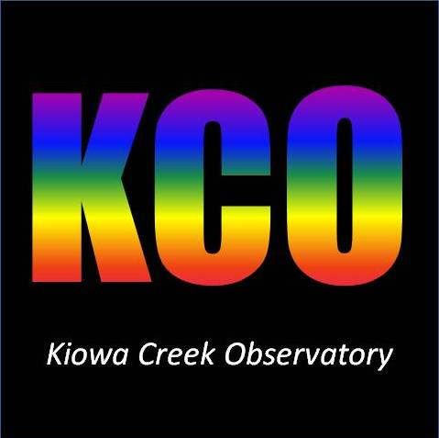
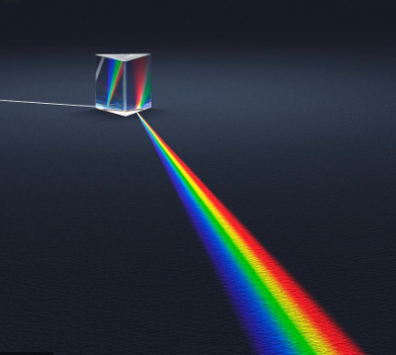
Atmospheric Differential Refraction and Spectrometer Slit Rotation
S. Donnell, Kiowa Creek Observatory
AAVSO, Colorado Springs Astronomical Society
donnellsp@gmail.com

Slide 2

Atmospheric Differential Refraction
Atmospheric differential refraction is the wavelength-dependent refraction as light passes through the atmosphere.
Blue is refracted more than red.
Refraction is perpendicular to the horizon – an image of a star is actually a small spectrum in the vertical direction – blue on top and red on the bottom.

Slide 3
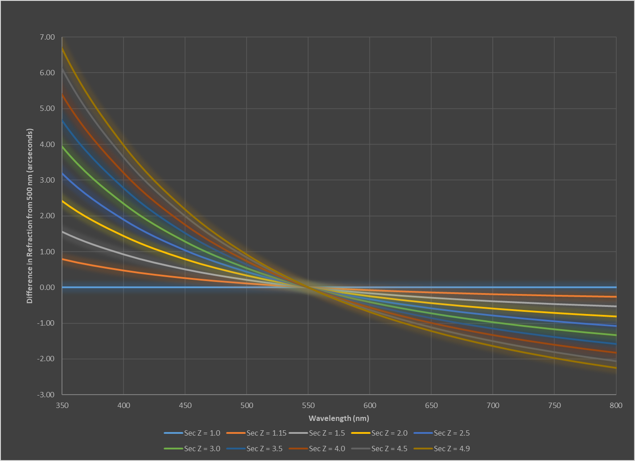
Atmospheric differential refraction, or dispersion, varies with zenith angle and wavelength.
Dispersion is zero at the zenith and increases with increasing zenith angle.
The difference in dispersion in blue and red also increases with increasing zenith angle.
Sec(z) >>1 Sec(z) > 1
Sec z ~ air mass

Slide 4
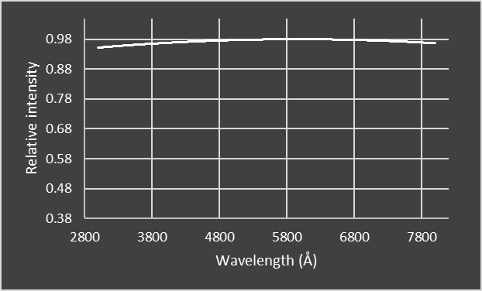
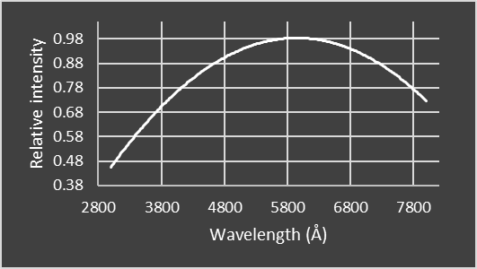
Effect of Slit Orientation
The amount of dispersion is comparable to the width of a slit in a typical spectrometer
A slit oriented perpendicular to the horizon will pass most or all of the light across the spectrum.
A slit oriented horizontal to the horizon will have a decrease in intensity in the blue and red ends.
Mostly affects slit spectrometers with broad spectral ranges and narrow slits.

Slide 5
Dispersion results in a decrease in intensity of light passing through the slit on the blue and red ends of the spectrum.
This reduction in intensity increases with increasing zenith angle.
Reduction in intensity also means a decrease in signal to noise.
Relative and absolute flux calibration is compromised.
-18% at sec z = 1.5
Slit Parallel to Horizon
Sec z ~ air mass

Slide 6
Effect on Calibration
Relative Flux Calibration
  Also known as atmosphere/instrument response correction.
  No effect if both the target spectrum and reference star spectrum are obtained with the slit perpendicular to the horizon for both objects.
  If the reference star spectrum was obtained at one slit angle and the target star another, then there will be a difference in the blue/red response that will remain after the atmosphere/instrument response correction has been applied to the target star.
  This will generally be the case for any fixed slit orientation.
Absolute Flux Calibration
  Same issue as with relative flux calibration.

Slide 7
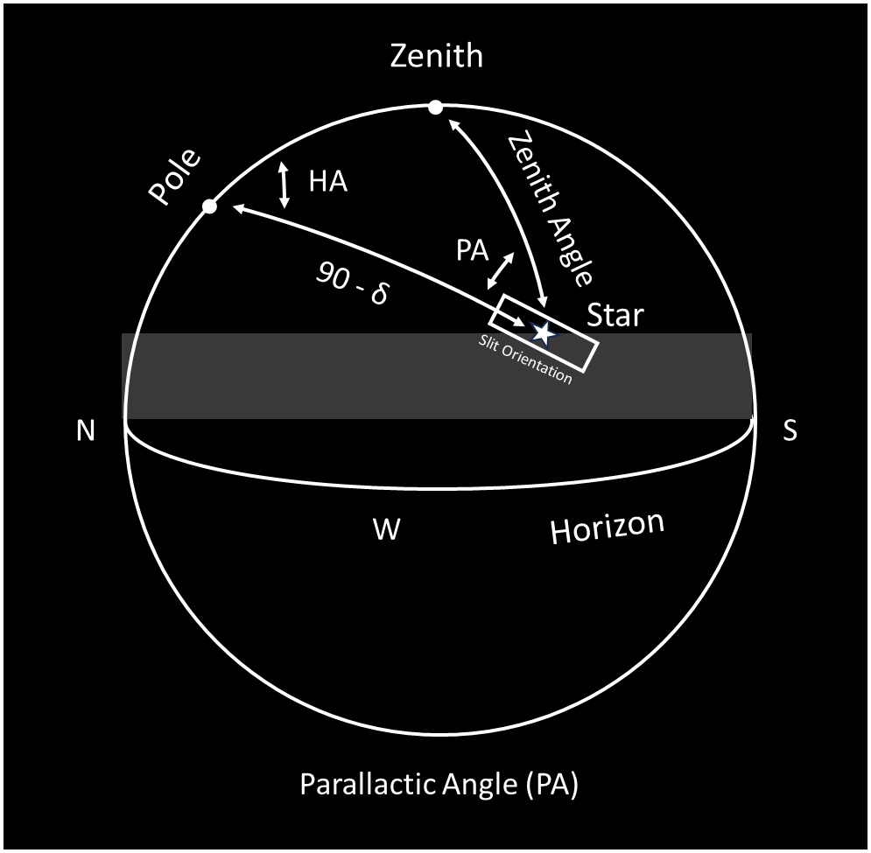
Setting the Slit Parallel to RA/Hour Circles
Typical fixed slit orientation.
Slit is oriented perpendicular to the horizon when facing south.
Slit remains fixed thereafter - parallel to the hour circles and in the direction of the pole.
Zenith
Pole
Parallactic Angle
E
Slit Orientation
S
W
Horizon

Slide 8
Parallactic Angle by Declination and Hour Angle
Latitude 40 deg N
Zenith

Slide 9
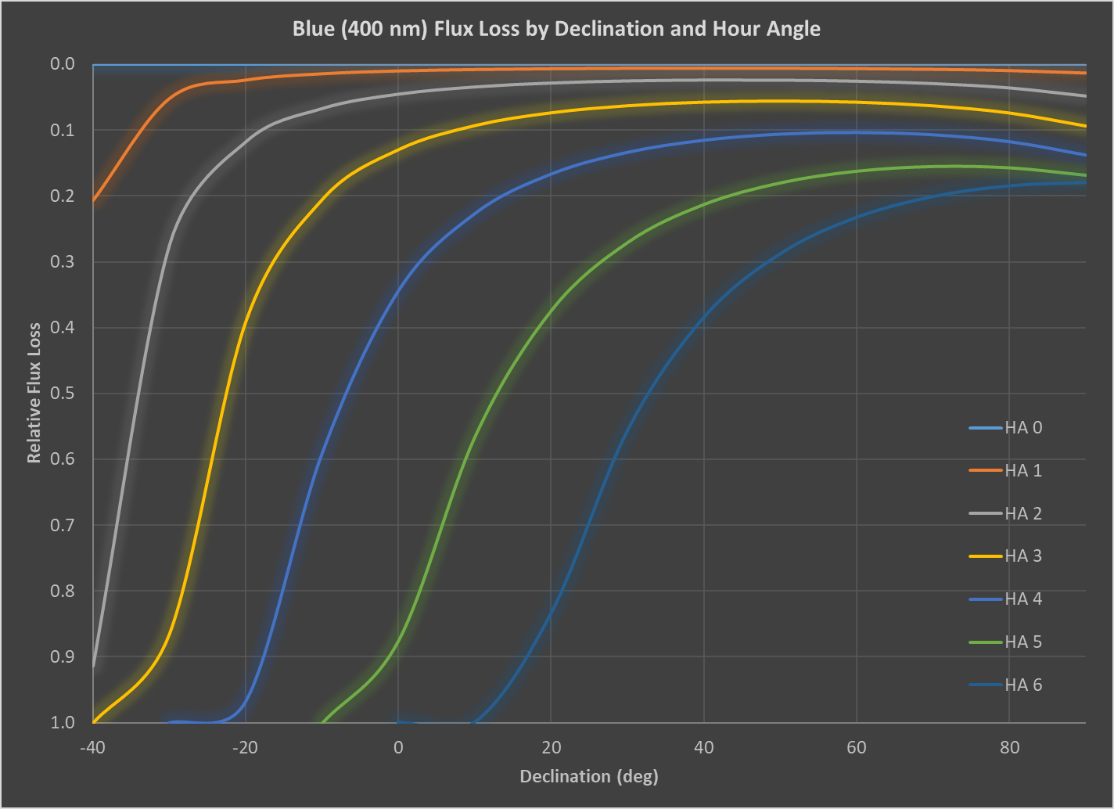
Flux loss at 400 nm (relative to 550 nm) for a slit parallel to RA/hour angle circles
Zero flux loss at zenith since dispersion is zero.
Larger hour angles and lower declinations contribute to increasing air mass with a resulting flux loss

Slide 10
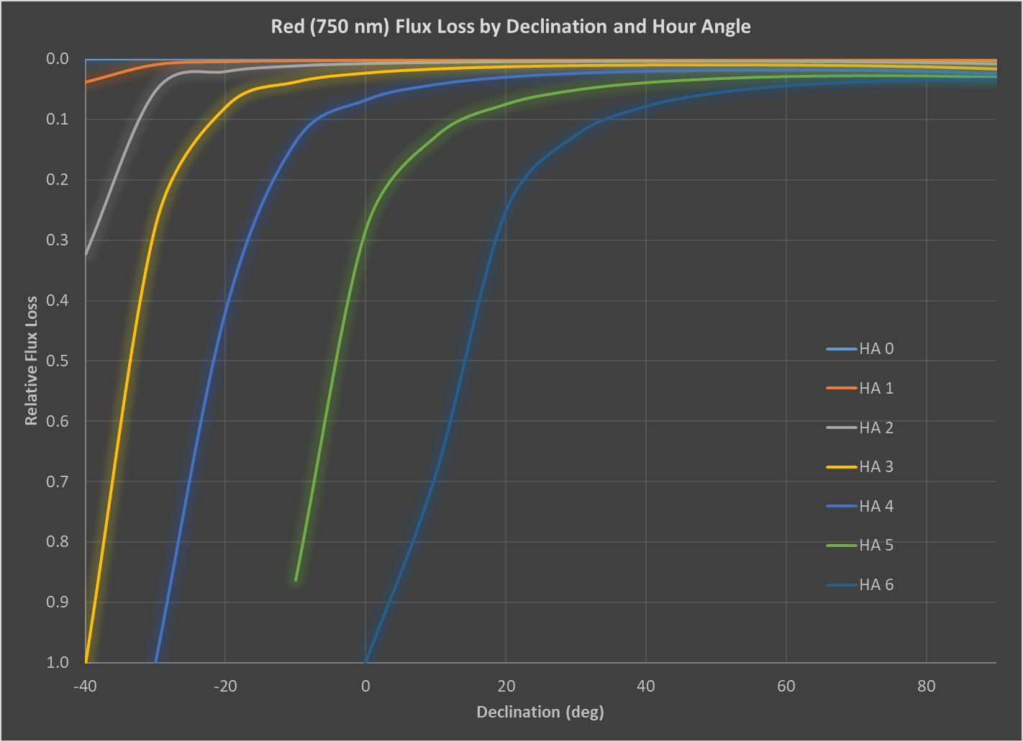
Flux loss at 750 nm (relative to 550 nm) for a slit parallel to RA/hour angle circles
Losses are less than on the blue end, but still a concern for larger hour angles and lower declinations

Slide 11
The Miracle of Slit Rotation
By rotating the slit for both target and reference stars to be perpendicular to the horizon you:
  Minimize or eliminate entirely the loss of flux and signal to noise at the blue and red ends of the spectrum.
  Allow for the construction of a better atmosphere/instrument response curve by ensuring that the slit orientation for both target and reference is at the same parallactic angle.
  Generate a more accurate absolute flux calibration.
Zenith
Pole
E
S
W
Horizon

Slide 12
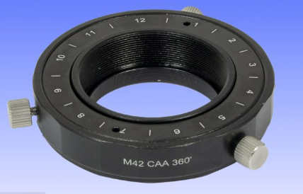
Rotating the Slit
Ideally, the slit should be rotated continuously throughout the exposure - generally not practical for amateur setups.
A compromise solution is to set the slit orientation to be perpendicular to the horizon at the exposure mid time, minimizing slit loss.
A manual rotator between the spectrometer and scope allows for rotation of the spectrometer while keeping it firmly attached to the scope.
About $55 from Agena Astro.
Blue Fireball Camera Angle Adjustor / Rotator

Slide 13
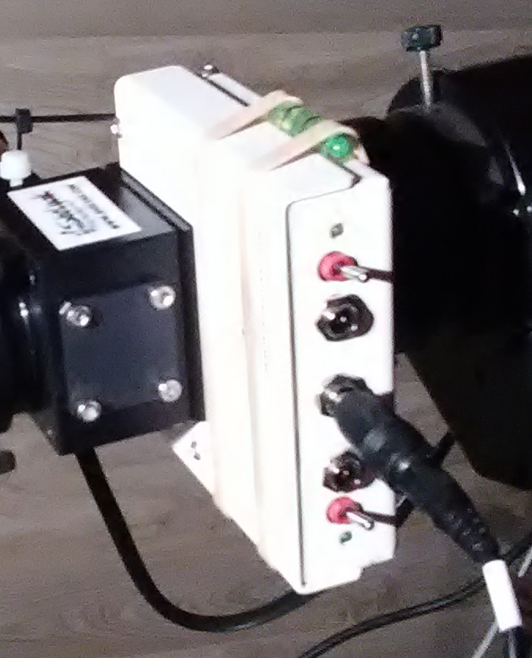
Orienting the Slit to Zero Parallactic Angle
Bubble Level
Attach a bubble level to your spectrometer.
Easy to determine when your slit is perpendicular to the horizon.
No need to calculate and dial-in parallactic angles.

Slide 14
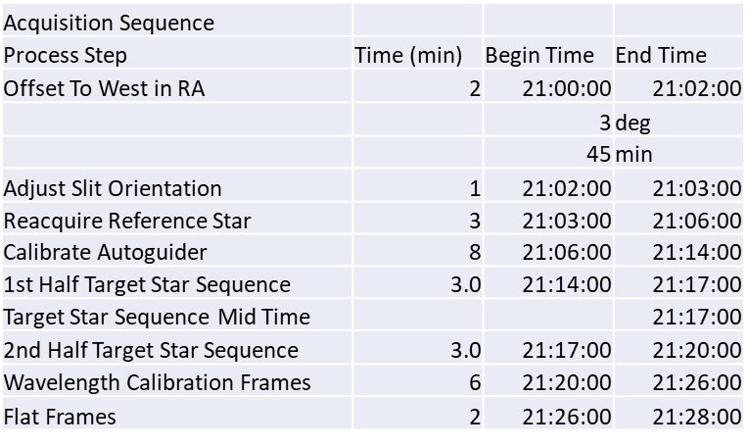
Method for Setting the Slit Orientation
Goal is for the slit to perpendicular to the horizon at the exposure mid-time.
Prior to the target or reference star exposure start time, move the scope to the west and rotate the spectrometer so that the slit is perpendicular to the horizon (i.e, the bubble is centered in the level).
Move the scope back to the target/reference star and wait until the indicated exposure start time.
If all goes well, the slit will be in the correct orientation perpendicular to the horizon at the exposure mid time.
Offset = Delta Time * Earth rotation rate
Example: Delta Time = 21:17 – 21:02 = 15 min
Earth rotation rate ~ 0.25 deg/min
Offset = 15 * 0.25 = 3.75 deg = 3 deg 45 min

Slide 15
Additional Comments
Applies to broad spectrum spectrometers like the Alpy 600
  Slitless setups need not worry.
  High resolution spectrometers mostly unaffected due to their narrow spectral range.
A properly rotated slit will still result in some reduction in intensity at the red and blue wavelengths over the exposure time.
  Especially true for long exposures.
  Minimize by setting slit angle for mid-exposure time
  Difference in exposure times between target and reference will introduce some difference in the blue/red flux even if the slit is oriented properly.
For very long exposures, setting the slit parallel to the horizon may be a better option (Szokoly, 2005)

Slide 16
Slit Loss Calculator
Input the conditions specific to your equipment and target star to determine the slit loss for any of three slit orientations: 1. Perpendicular to the horizon (ideal), 2. Parallel to RA/hour circles, and 3. Parallel to the celestial equator.

Slide 17
Slit Loss Calculator

Slide 18
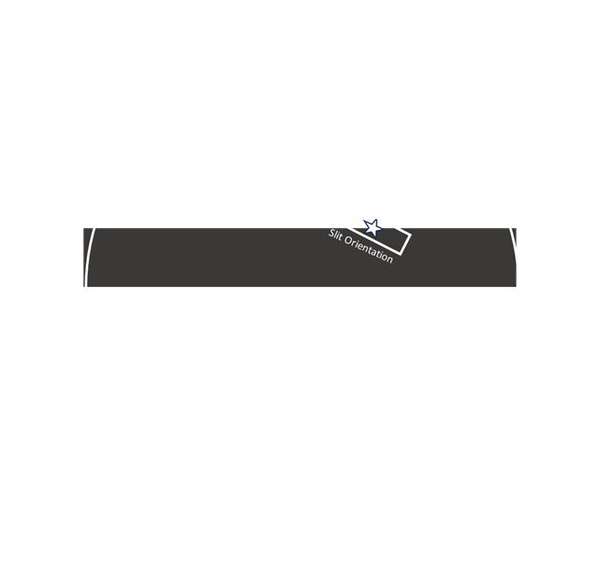
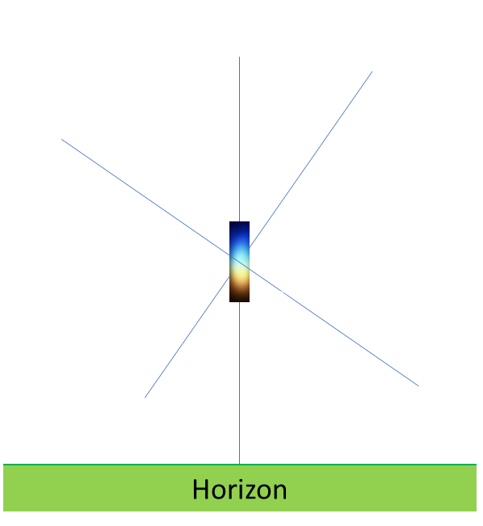
Example: Target and Reference Star with Slit Parallel to RA/Hour Circles

Slide 19
Results From Slit Loss Calculator for Target and Reference Stars
Both stars show losses at 400 nm and 700 nm
Difference in slit loss is ~13% for 400 nm and ~2.6% for 700 nm

Slide 20
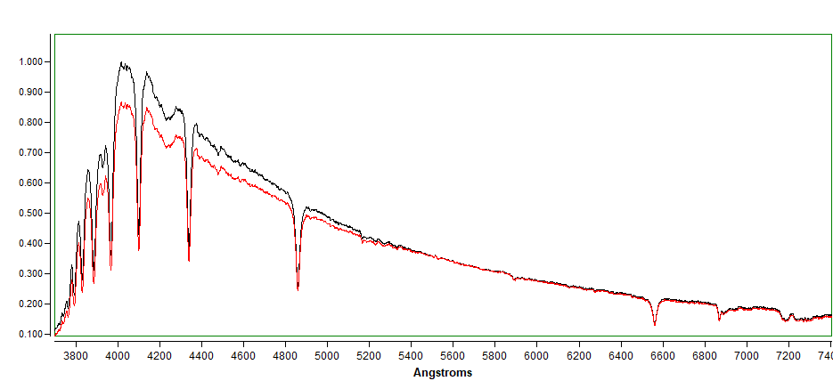
Effect on Spectral Profile
-13%
Black – Spectrum Calibrated with No Slit Losses
Red – Spectrum Calibrated with Slit Losses

Slide 21
Summary
Wavelength-dependent atmospheric refraction (dispersion) causes starlight to be differentially refracted in a direction perpendicular to the horizon.
A slit oriented in any direction other than the perpendicular results in a significant loss of intensity at the blue and red ends of the spectrum.
This is a problem primarily for spectrometers like the Alpy 600 that produce a spectrum across the visual range.
This loss of intensity adversely affects the quality of the atmosphere/instrument response correction as well as absolute flux calibration
This problem is easily mitigated by rotating the slit to the optimal angle for both the target and reference stars.

Slide 22
References
Alexei Filippenko (1982), The Importance of Atmospheric Differential Refraction in Spectrophotometry, https://articles.adsabs.harvard.edu/pdf/1982PASP...94..715F
Ref: Szokoly, 2005, Optimal slit orientation for long multi-object spectroscopic exposures
https://arxiv.org/abs/astro-ph/0506688

Slide 23
Questions?

Slide 24
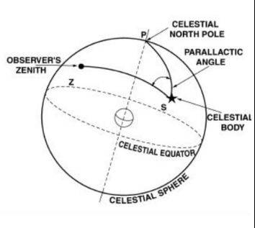
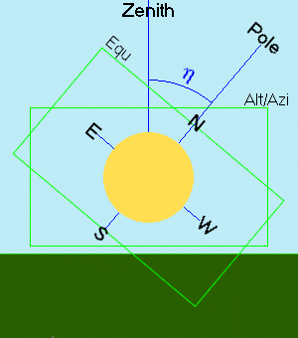
Parallactic Angle
The parallactic angle is the angle between the great circle through a celestial object and the zenith, and the hour circle of the object.

Slide 25
Zenith
90 -φ
Pole
h
Z
θ
90 - δ
Star
Slit Orientation
N
Horizon
S
W

Slide 26
Zenith
Pole
Zenith
Pole
Parallactic Angle
E
E
S
W
S
W
Horizon
Horizon

