Slide 1

AAVSO
Variable Star
Telescope
Simulator
Learn how
to have fun
making variable star observations!
Click the left mouse button to start

Slide 2
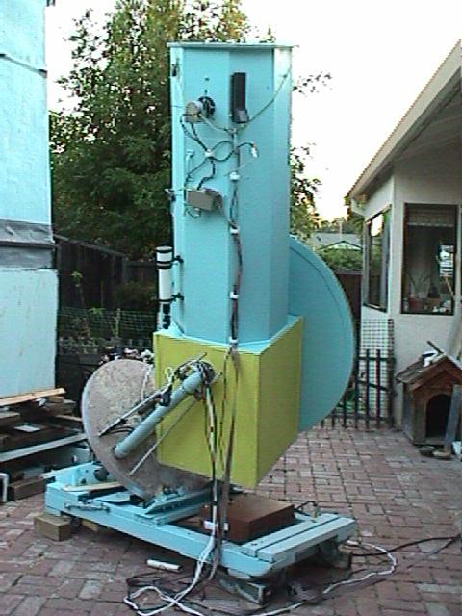
How to operate the telescope simulator
To change to the next slide, click on the left mouse button.
Some of the detailed photos may take a moment to load-- please wait.
AAVSO member Lew Cook’s
44-cm newtonian telescope

Slide 3
In case of difficulty...
If you have any problems with this system or in understanding the material, please stop and ask a helper for assistance.
And now, let’s begin!
Variable Star Observers Wear Many Hats!

Slide 4
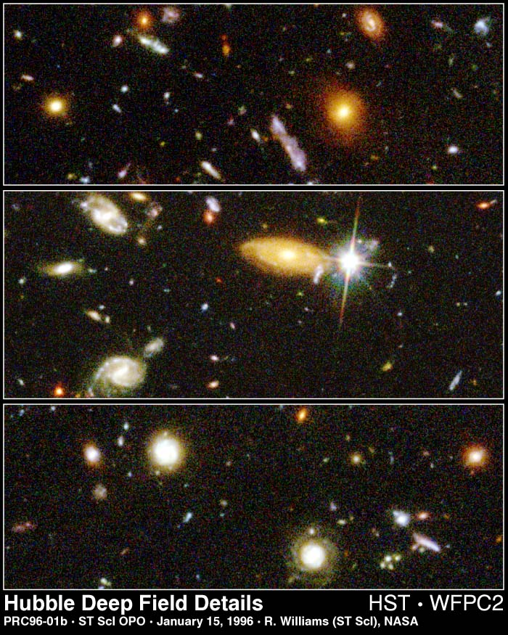
Welcome to the AAVSO telescope simulator!
Today, you will learn how to perform a valuable scientific measurement--star brightness.
You’ll also learn how much fun it can be to do real science from your own backyard.

Slide 5
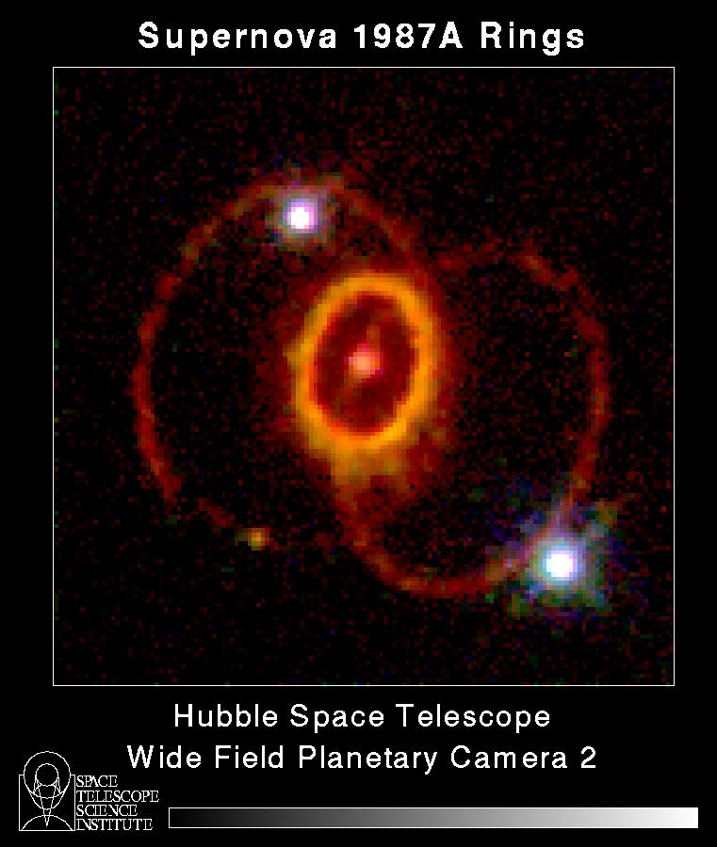
What you’ll learn
This learning experience will take about 15 minutes.
In addition to estimating brightness, you’ll learn how to find variable stars with AAVSO charts.
Supernovae are Variable Stars too!

Slide 6
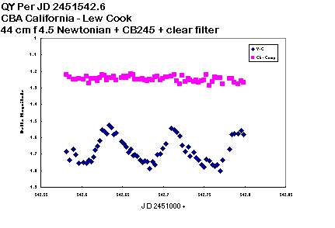
What you’ll learn
We’ll also cover how scientific data can be useful even when it contains “noise”.
You’ll learn that your observations can be very valuable, even while you’re learning to make better and better estimates.
Constant (comparison) star
Variable star
CCD brightness data from long time AAVSO
Member Lew Cook

Slide 7
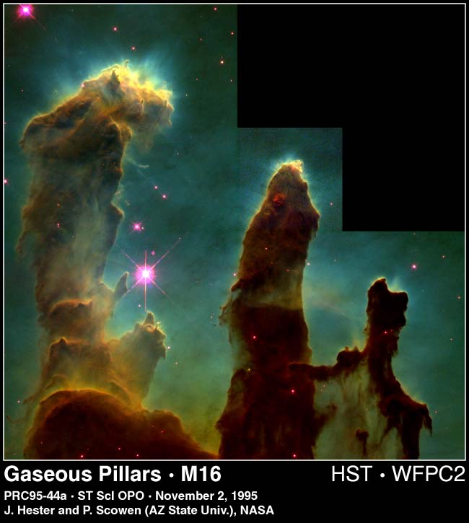
Astronomy needs data!
The sky is full of wonderful things to see.
But, just looking at its beauty often doesn’t provide answers to the riddles of the universe.
Hubble Space Telescope

Slide 8
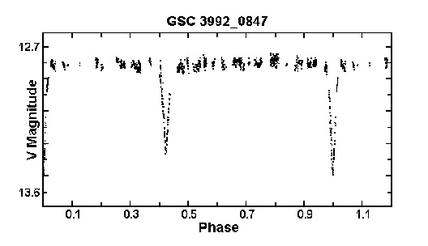
Astronomy theories need data!
Most of the discoveries astronomers have made about the universe needed light measurements to confirm or suggest theories.
(Time)

Slide 9
Data is information from instruments
There are all kinds of instruments astronomers use to make measurements of star brightness.
We call these measurements photometric data.
Photometric means light-measuring.

Slide 10
Your eyes are your instruments
You are going to use your own eyes and a special technique for making photometric measurements.
The technique is called: Interpolation of Magnitude.

Slide 11
What is interpolation?
Interpolation is a word scientists use when a measurement is estimated between two known values.
People interpolate all the time!

Slide 12
Interpolation
Your car’s gas gauge needle is half way between empty and 1/4 tank.
You interpolate you have 1/8 of a tank left--time to get gas!
1/2
1/4
3/4
E
F

Slide 13
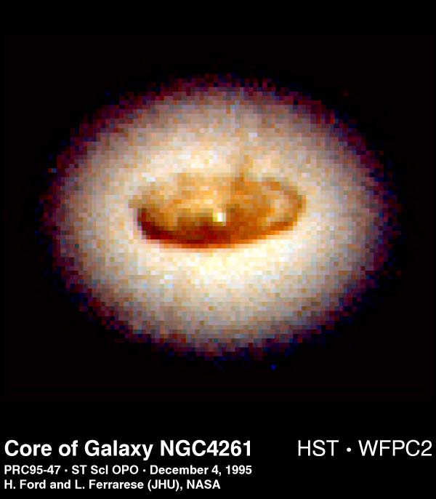
Interpolating star magnitude
Making a brightness estimate is easy in theory but requires some practice.
We call the measurement of brightness the star’s magnitude.

Slide 14
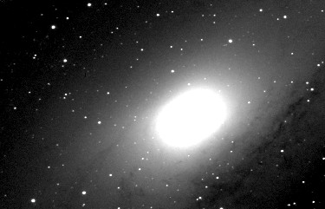
Interpolation of magnitude
We estimate the brightness of the variable star by using at least two stars of known brightness; one brighter than the variable, one fainter.
Andromeda Galaxy (C. Pullen)

Slide 15
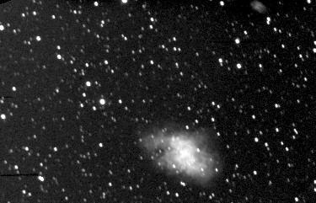
Interpolation of magnitude
Just like the gas tank example, if a star’s brightness seemed about half way between two stars that were known to be magnitudes 5.0 and 6.0, what is the magnitude of the variable star?
Crab Nebula (C. Pullen)

Slide 16
Interpolation of magnitude
That’s right -- half way between 6.0 and 5.0 is
5.5!

Slide 17
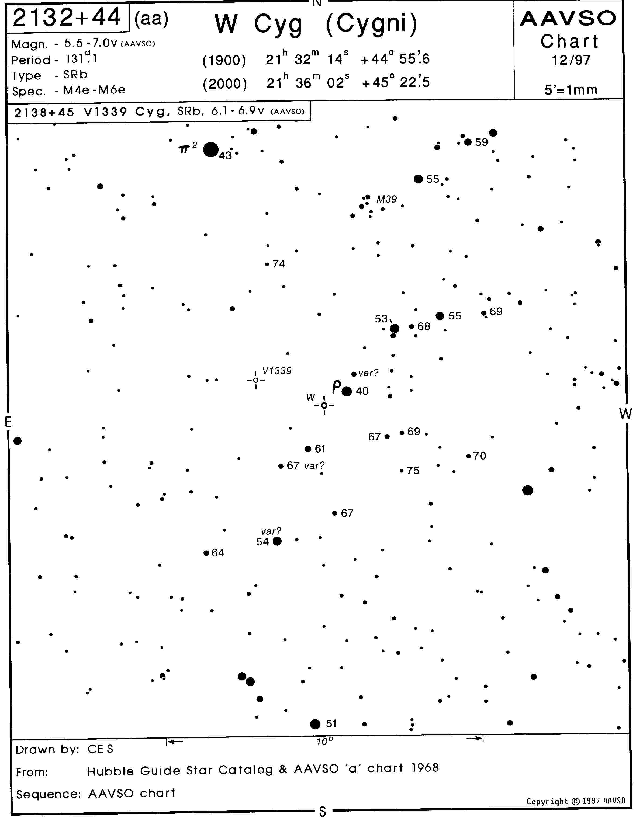
How to find a variable star
The AAVSO makes thousands of star charts (sky maps, like road maps) used to find and estimate the magnitude of variable stars.
Because all AAVSO observers use the same charts, our results can very good, and can be compared with each other’s.

Slide 18
How to find a variable star
A copy of a chart you will use is next to the monitor. It is for W Cygni, a star you can find with binoculars from you own yard.
But, first let’s try a simple lesson in interpolation and using star charts.

Slide 19
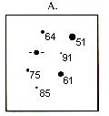
Variable and comparison stars
Look at the example below. The variable is shown
between the four focus lines. The magnitudes of the
comparison (“comp”) stars are shown on the chart
next to the stars (64,51,91, etc.).
Variable

Slide 20
Decimal points can be confusing
Note that the star magnitudes are actually decimals but we
don’t show the decimal point because it could be confused
as a star. So, the magnitudes below are really 6.4, 5.1, 9.1, etc.
Variable

Slide 21
A big magnitude number is faint, a big dot is bright!
The brighter the star is, the smaller its magnitude number.
5.1 is brighter than 6.4.
On the chart, notice that the dot is bigger (brighter) for the 5.1 star than the 6.4 star to its left.
Variable

Slide 22
Making your first estimate
Is the variable brighter or fainter than the brightest (5.1) star?

Slide 23
Making your first estimate
Is the variable brighter or fainter than the brightest (5.1) star?
Fainter!

Slide 24
Making your first estimate
Is the variable brighter or fainter than the next brightest
star (6.1)?
Variable

Slide 25
Making your first estimate
Is the variable brighter or fainter than the next brightest
star (6.1)? Fainter!
Variable

Slide 26
Making your first estimate
Is the variable brighter or fainter than the next brightest
star (6.4)?
Variable

Slide 27
Making your first estimate
Is the variable brighter or fainter than the next brightest
star (6.4)? Brighter!
Variable

Slide 28
Here comes the gas gauge!
So, the variable is brighter than 6.4 but not as bright
as 6.1. What are you going to do with those numbers?
Interpolate!
Variable

Slide 29
Interpolation is an educated guess
Is it about half way between 6.4 and 6.1?
Then, your estimate would be 6.2 or 6.3.
But, which one?
Variable

Slide 30
Use your feelings
Maybe you think it is just a little brighter than midway.
Your estimate would be 6.2! A little fainter, your estimate
would be 6.3.
Don’t try to think
what it should be,
just go with the
flow.
Your ability to
feel the best
answer will
get better
with practice.

Slide 31
Making your first estimate
But, whatever your estimate, congratulations on your first variable star observation!
Write your result on the observation form you were given.

Slide 32
Why do we call it an
Estimate?
Different people will make different estimates of brightness using this method. We all see the world differently.
Yet, all the estimates are “right”! There is no one correct answer.
All scientific measurements have variation. We call it error or noise.

Slide 33
I thought scientists only used exact numbers!
Well, a number can never be too exact in science, especially astronomy. But, all measurements are really estimates to a certain precision. The trick is understanding what that precision is.

Slide 34
Precision in data
The graph on the right is a portion of the AAVSO data that show the change in brightness over time of a star called SS Cygni.
We call this a light curve.
SS Cygni is located in the constellation of Cygnus the Swan.
Brightness
Time

Slide 35
Precision in data
SS Cygni brightens dramatically every few months.
Each dot represents a measurement made by an AAVSO observer somewhere in the world. We have records on some stars back to 1911!
You can make measurements too like these too!
Brightness
Time

Slide 36
Precision in data
The magnitude is plotted on the Y axis (up and down)
The day and time of the observation is plotted on the X axis (left and right)
Brightness
Time

Slide 37
Precision in data
You can see the noise in the data.
Note that the curve is not a nice straight line.
Rather, it is a wide band of individual observations.
Brightness
Time

Slide 38
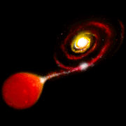
Every estimate is needed
Astronomers and physicists can use even noisy data to learn many things about how stars work.
With practice, AAVSO visual observers can estimate brightness to a precision near 0.1 magnitude.
Artist’s Conception - SS Cygni (AAVSO)

Slide 39
There is no perfect estimate
Your observations are estimates because everyone gets a little different result.
You don’t have to be perfect--just do the best job you can.
Practice will help a lot!

Slide 40
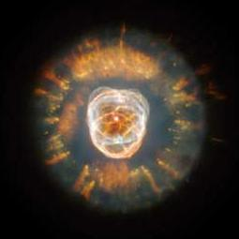
Want to try again?
Let’s Do It!
Cat’s Eye Nebula (Hubble Space Telescope)

Slide 41
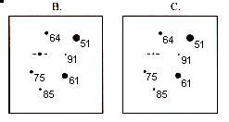
More practice
This time, estimate the same variable but in frames B and C. These frames could be the variable star at different times in its light curve.
Write your answers on the form.

Slide 42
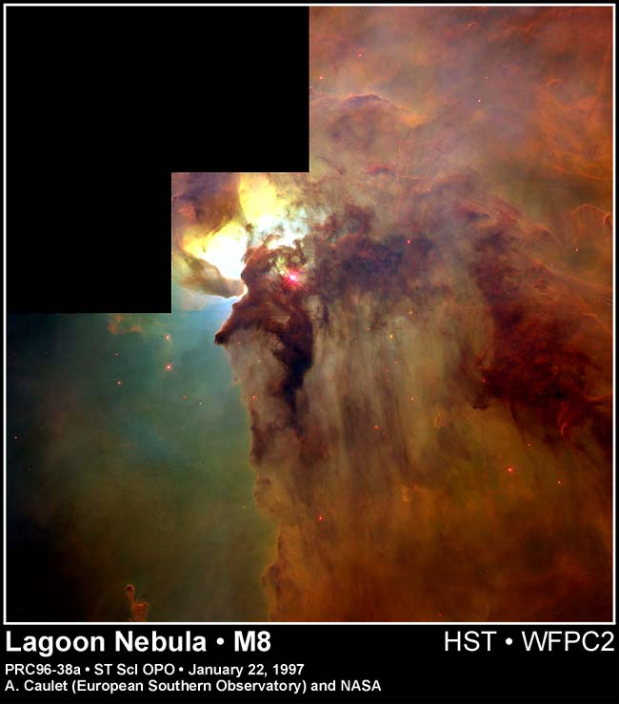
How did it go?
Was it easier the second
and third time?
I bet you are ready for a real star.
Let’s try one!

Slide 43
W Cygni
We are now going to make two estimates of a semi- regular star called W Cygni (W Cyg). You should have its chart in front of you.
Click and it will be the next picture.

Slide 44
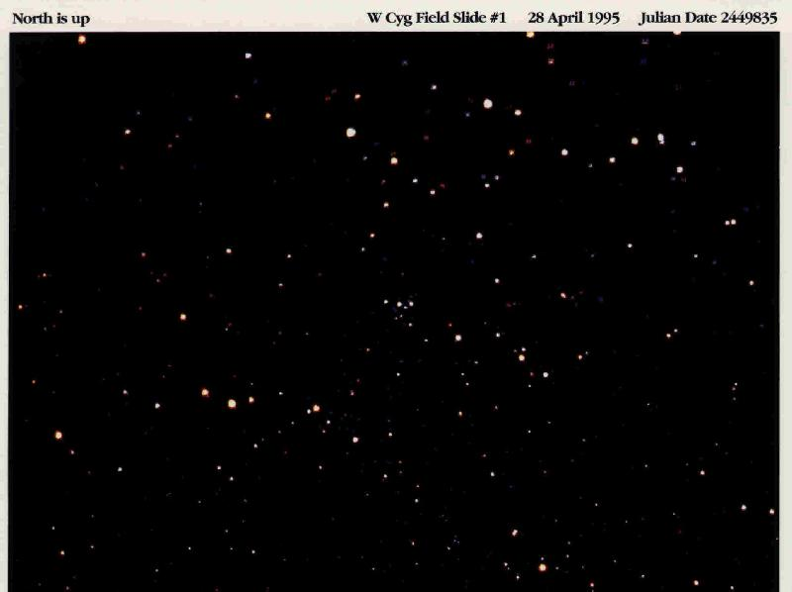
Are you able to find it?
(Click for a little help!)

Slide 45
You’re kidding!
OK, there are lots of stars in the picture...
You will need to learn to “star hop” to the star you want. But it’s easy.
Here’s how!

Slide 46
W Cyg first estimation
Take a look at the AAVSO W Cyg (size aa) chart.
Hold it so that it is tilted about 45 degrees clockwise (to the right). It will better match the picture if tilted a little.

Slide 47
Why tilt the chart?
The way a group of stars looks in a telescope can vary because of the type of telescope, how you look into it, and the season or time of night.
?

Slide 48
Why tilt the chart?
Learning how to match the telescope view to the chart is something you’ll learn when actually observing.
But, back to our estimate!

Slide 49
Finding landmarks
Find the following things on your chart in this order:
1) M39 (star cluster)
2) Comp star 53 and a line of stars pointing from it to the south
3) Rho (pronounced “row”) Cyg, a Greek letter that looks like a “p”
4) W Cyg

Slide 50
I’ll give you some help.
M39
5.3 Comp star with
line to the south
Rho Cyg
W Cyg

Slide 51
Finding landmarks
This is how you star hop--from the easiest thing to see to the variable star.
Now, let’s try it on the photo!
We’ll go full screen and I’ll show you the landmarks we just found on our chart.

Slide 52
M39
W Cyg
53 comp with line of stars
Rho Cyg

Slide 53
Can you find
the landmarks
on your own?
See if you can
find the comp
stars as well.
Did you find
them?

Slide 54
Here are some
of the comp
stars.
74
55
59
67
Can you find
any more?

Slide 55
Now that you have found the comp stars, try to
estimate W Cyg.
Write your estimate on the form.
We’ll keep a
pointer on W in case you get lost.

Slide 56
How did you do?
Were you able to do it?
If not, or if you had a lot of trouble finding things, ask the helper before the next (and last) estimate.

Slide 57
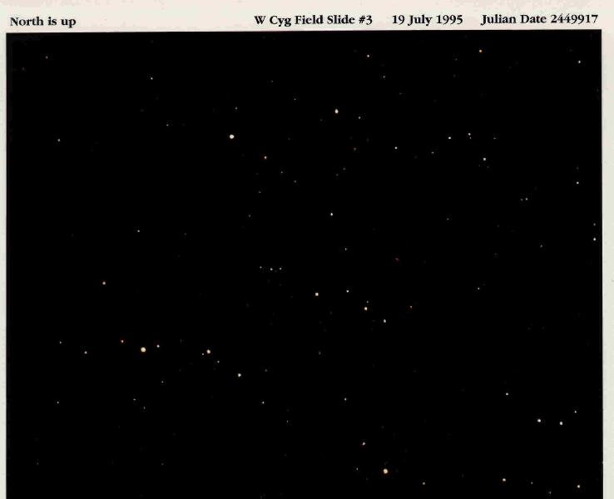
Here is a photo of W Cyg taken 82 days later.Try another
estimate.
Write the result on your form.
If you need help finding it, click to the next slide.

Slide 58
Does that help?

Slide 59
Note that the
photo doesn’t
look like the
one in April.
This is because the sky changes
appearance from season to season and even night
to night. This
change is one of the challenges of variable star observing!

Slide 60
How did you do?
Is it getting easier to make the estimates?
Did you have less trouble finding W Cyg and the comparison stars?
Practice really helps, doesn’t it!

Slide 61
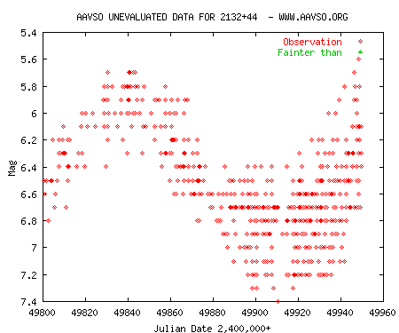
Is that your final answer…?
On the right is a section of the light curve of W Cyg from the AAVSO data base.
The two dates on which you made estimates are shown with dashed lines.
April 28
July 19

Slide 62
Is that your final answer…?
On April 28 the observations were between about 6.3 and 5.7 magnitude.
On July 19, the observations were between about 7.3 and 6.4 magnitude.
April 28
July 19

Slide 63
Is that your final answer…?
How did you do compared to other AAVSO observers?
If one or more of your estimates are outside of the band of results, why?
April 28
July 19

Slide 64
If your results were different from AAVSO observers’...
Practice helps. Some AAVSO observers have made thousands of measurements.
You were looking at a computer, not the sky.
You are still learning!
Variable star observing can be very
challenging sometimes!

Slide 65
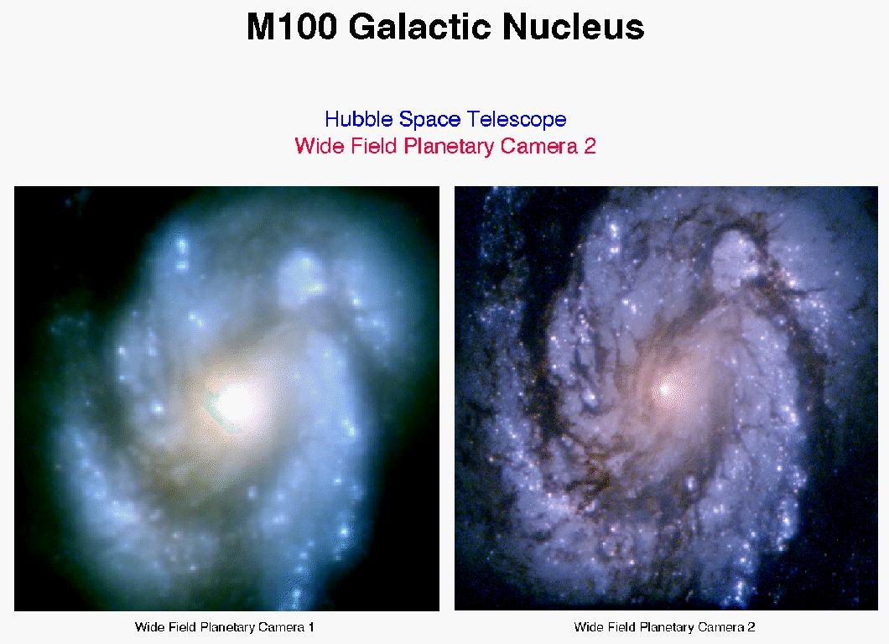
You are teaching your eyes to see the world differently!
Many new observers need time before they can see fine differences in brightness. This takes practice but is a skill that can help you enjoy all the beauty in the night sky.

Slide 66
You are a winner!
The helper will plot your results today along with everybody else’s.
I bet you did pretty well!
While it’s not a contest, look at the curve and see how you did.
Be it Known that
on This Day...
I learned how to
measure the
brightness of a
variable star!

Slide 67
So what did you learn?
You learned how to find variable and comparison stars using AAVSO charts and a technique called star hopping.

Slide 68
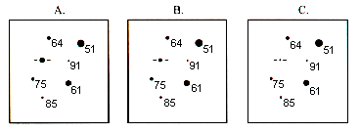
So what did you learn?
You then learned how to estimate the brightness of a star using a technique called interpolation of magnitude.

Slide 69
So what did you learn?
You learned that your data is valuable even as you are perfecting your technique because everybody gives their best estimate and astronomers really use even noisy data.

Slide 70
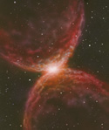
Where do I go from here?
Variable star observing can be rewarding and fun!
Ask your helper for more information.
Included in the information package are some actual charts and projects you can do starting tonight!

Slide 71
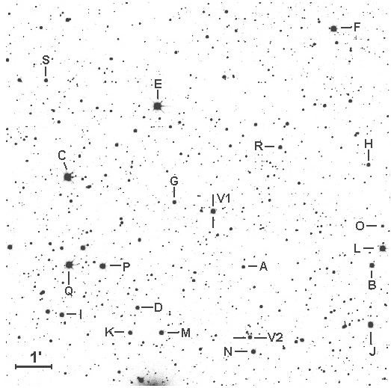
Variable star observing is fun!
The changing night sky is something that can fascinate you for years to come.
You can expand into new and exciting measurement technologies such as CCD photometry or analyze your data and other people’s just like scientists do!
Comp stars around a new variable star
(US Naval Observatory Photo)

Slide 72
Help Professional Astronomers
AAVSO members participate with NASA an other professional astronomers in their research.
One day, the Hubble Space Telescope may even move to look at a star because of your observations!

Slide 73
The AAVSO can help you grow as a variable star observer
AAVSO offers a number of free services, including charts, from its web site--www.AAVSO.org
AAVSO membership provides a number of other benefits:

Slide 74
Mentor Program
Member benefits include a mentor program to team you up with an experienced variable star observer in your area. You can learn a lot in just one night!

Slide 75
Publications, meetings, and more!
AAVSO also offers a newsletter, twice-yearly meetings, a Journal, an internet discussion group, special project groups, and many more ways to increase your enjoyment of astronomy.

Slide 76
Ask you helper...
Your helper can answer all of your questions about the AAVSO and variable star observing.
Please ask!

Slide 77

Thank you for learning how to estimate brightness!
We hope variable stars bring you years of enjoyment!

Slide 78

Estimating star magnitude: First steps in variable star astronomy
Adapted from Hands-On Astrophysics: Variable Stars in Science, Math, and Computer Education by Janet A. Mattei et al, 1997
PowerPoint Presentation developed by
Chuck Pullen, AAVSO

Slide 79
Credits and Acknowledgements
Janet A. Mattei, Director, AAVSO
Kerriann Malatesta, Technical Assistant AAVSO
Lew Cook, AAVSO
Lance Shaw, AAVSO
Dan Kaiser, AAVSO
Victor, Nancy, and Kyle Jewhurst
Christine Miller, California State University Sacramento
And all those who helped test the early versions of this presentation!

